Slide 1
Interpret machine learning models
PyData Calgary Meetup
Emma Liu
Oct 24 2018

Slide 2
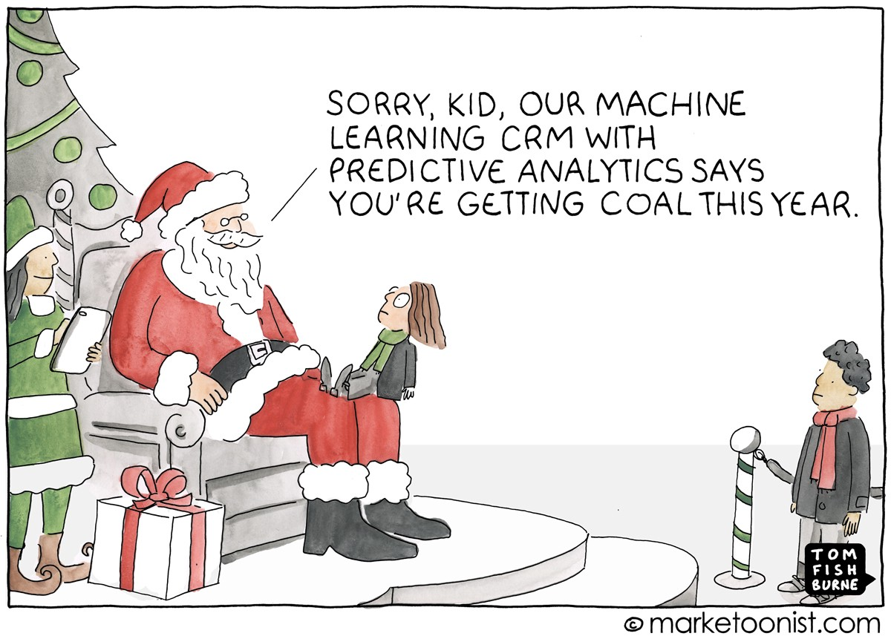
Why Interpretability?

Slide 3
Definition and Importance
Interpretability is the degree to which a human can understand the cause of a decision.
Why it’s important?
Human curiosity and learning → Predictive to Prescriptive!
Comprehend unexpected events
Debugging and testing, especially when model inaccuracy has significant impact
Identify and mitigate biases
Build trust
When interpretation is not required?
Model has no significant impact
Problem is well-studied
When proxies are used, interpretability may enable gaming the system
https://christophm.github.io/interpretable-ml-book/

Slide 4
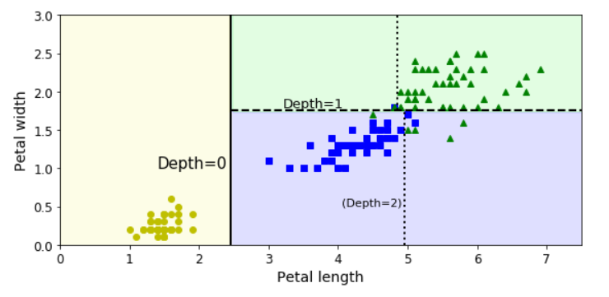
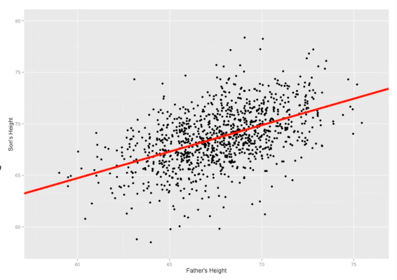
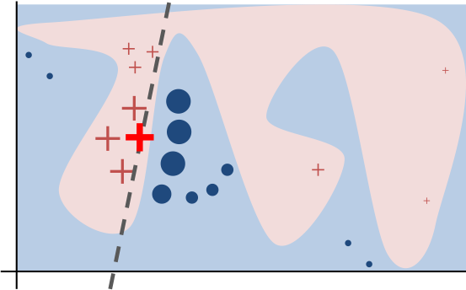
Transparency, Local and Global Interpretability
Transparent algorithm
vs.
Transparent model

Slide 5
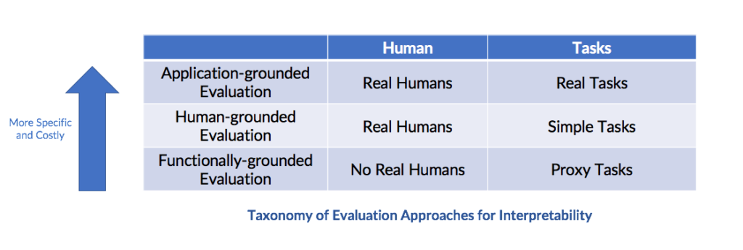
Interpretability Evaluation
“doctors performing diagnosis” ….and determine “whether it results in better identification of errors, new facts, or less discrimination”
“humans are presented with pairs of explanations, and must choose the one that they find of higher quality (basic face-validity test made quantitative).”
“shallow decision tree is more interpretable than deep ones”

Slide 6
Human Friendly Explanations
Why does model makes x prediction?
Contrastive
Selected
Social
Focus on the abnormal
Coherent with prior beliefs
Truthful
Generalizable
In business context:
Strategic
Actionable
Material

Slide 7
Interpretable Model vs. Model-agnostic
Intrinsically interpretable models
Select and train a model that is interpretable
Regression
Decision Tree
Decision Rule
RuleFit (Decision rule + LASSO)
Model-agnostic methods
Apply interpretability method AFTER training, requires no knowledge about the inner working of the model
Various effect plots of single feature
Feature interaction
Feature importance
Global surrogate models
Local surrogate models
Shapley Value

Slide 8
Linear Regression & Logistic Regression
Example: the height of a shrub (Height) based on the amount of bacteria in the soil (Bacteria) and whether the shrub is located in partial or full sun (Sun). Height is measured in cm, Bacteria is measured in thousand per ml of soil, and Sun = 0 if the plant is in partial sun, and Sun = 1 if the plant is in full sun.
Height = 42 + 2.3*Bacteria + 11*Sun
With one unit increase in Bacteria level, height will increase by 2.3 cm, controlling exposure to Sun
Height = 35 + 4.2*Bacteria + 9*Sun + 3.2*Bacteria*Sun
The effect of Bacteria on Height is now 4.2 + 3.2*Sun
For plants in full sun, with one unit increase in Bacteria level, the height of plan increase by 4.2+3.2 cm
Log odds of student in honor class = log(p/(1-p)) = logit(p) = – 9.8 + .17*math score
Exp(0.17) = 1.16
With one unit increase in math score, the odds of student in honor class increase by 17%
Easy to interpret
Additive relationship is useful for decision making
Performance may be bad
Assumption about data distribution
R
Base R
Python
Scikit-learn, Stats Models

Slide 9
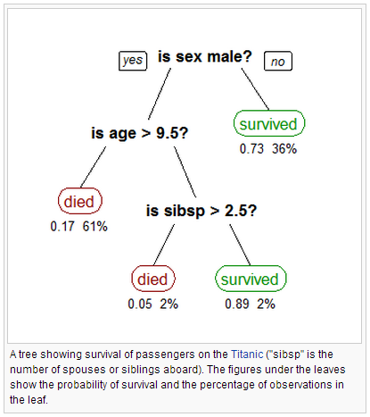
Decision Tree
Naturally interpretable
Create non-smooth steps when dealing with linear relationship
Unstable to change in training data
Tent to over fit for prediction task
R
rpart
Python
Scikit-learn

Slide 10
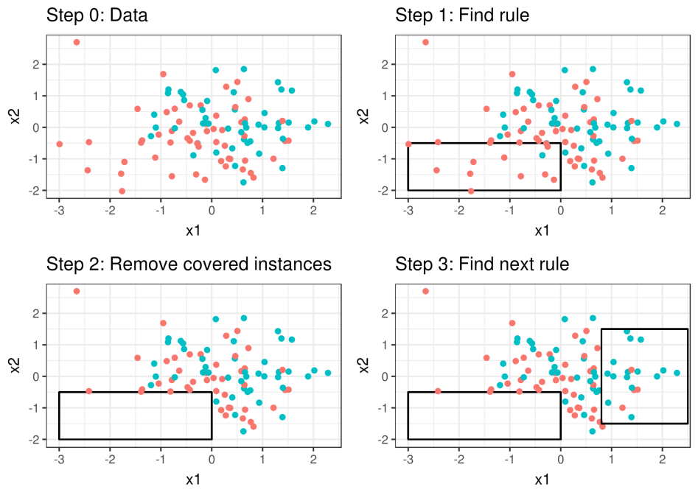
Decision Rule (related)
IF…THEN…
OneRule:
If female, survive
If age <9, survive
…
Choose rule that results in highest accuracy
Sequential covering:
Learn one rule that covers some instances (i.e., using one branch from decision tree)
Remove instances
Learn next rule; repeat
Bayesian rule lists
Find common rules
Reduce down to short and effective rules using Bayesian theorem
RuleFit
Fit sparse linear model
Include binary rules to capture interaction
Easy to interpret
More compact than decision tree
Fast to predict
Only for classification problem (except for RuleFit）
Features need to be categorical
R
OneR, RWeka
Python
RuleFit, weka, sklearn-expertsys

Slide 11
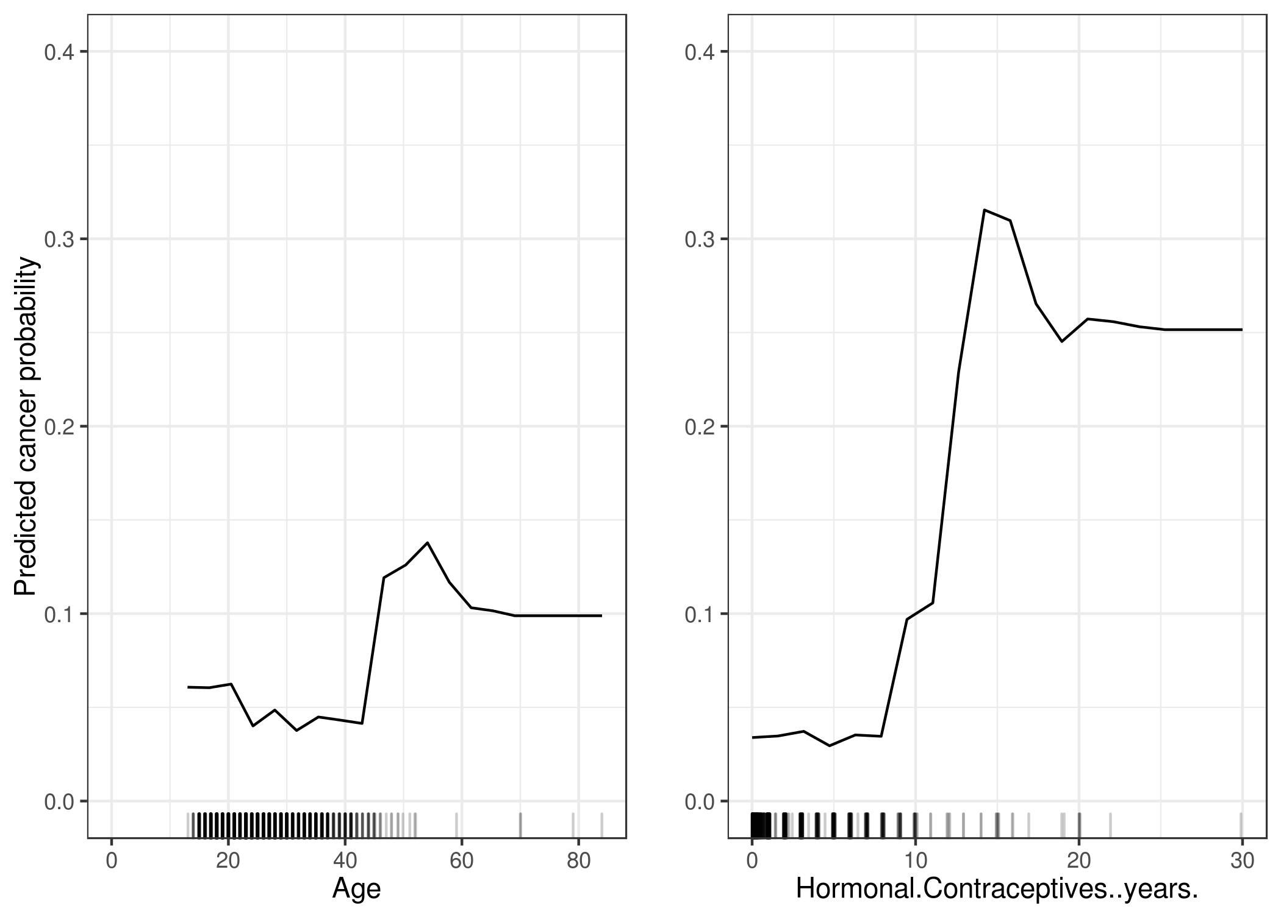
Effect Plots – Impact of 1 or 2 Features
Partial Dependence Plot (PDP)
Average prediction for a feature’s marginal distribution
Individual Conditional Expectation (ICE)
Same as PDP, but one line per instance
M-plots
Average prediction for a feature’s conditional distribution
Accumulated Local Effects (ALE)
Difference in prediction between a small range for a features’ conditional distribution
Partial Dependence Plots: “Let me show you what the model predicts on average when each data instance has the value v for feature xj. I ignore whether the value v makes sense for all data instances.”
M-Plots: “Let me show you what the model predicts on average for data instances that have values close to v for feature xj. The effect could be due to feature xj, but also due to correlated features.”
ALE plots: “Let me show you how the model predictions change in a small ‘window’ of xj around v for data instances in that window.”
R
iml, pdp, ICEbox, ALEplot
Python
PDPbox, PyCEbox, scikit-learn

Slide 12
Permutation Feature Importance
Feature importance in terms of accuracy
Shuffle each feature
Predict:
Test data with permutated feature j
Record accuracy
Repeat step 2 for all features
Order by drop in accuracy
Intuitive: the increase of model error when the feature’s information is destroyed
Does not require re-train
Account for all interaction effects
May introduce ‘unrealistic’ data points by shuffleing if features are correlated
Accuracy/error may not be relevant for certain interpretation scenarios
R
iml, mlr
Python
eli5

Slide 13
Global Surrogate Model
Predict using trained model
Train an interpretable model using prediction and features
Regression
Decision tree
Measure accuracy
R-square
Interpret surrogate model
Intuitive and flexible (multiple surrogate model options)
Explain the black box model to certain extent, but not the real data
Locally, the surrogate model may or may not reflect the black box model

Slide 14
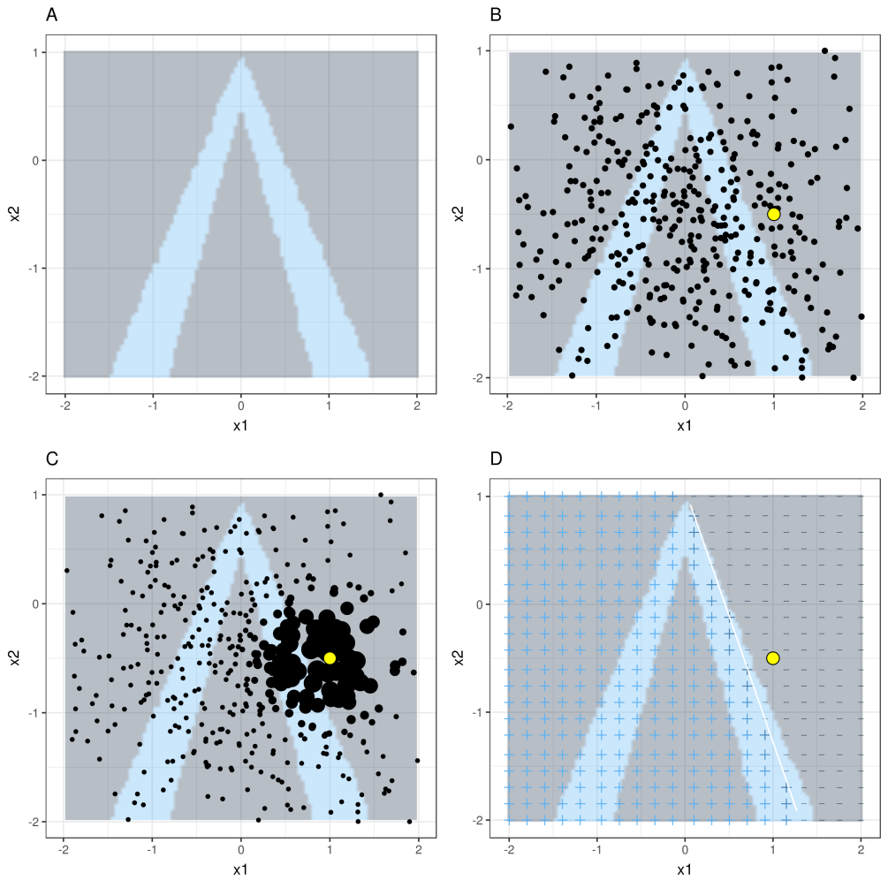
Local Surrogate Model (LIME）
Explain single prediction
Choose single instance of interest
Perturb a dataset and get the black box predictions for these new points.
Weight the new samples by their proximity to the instance of interest.
Fit a weighted, interpretable model on the dataset with the variations.
Explain prediction by interpreting the local model.
Selective explanation based on a few features
Can be slow for explaining a large number of instances
Defining distance is tricky in high dimensional; default kernel and kernel width
R
iml, lime
Python
lime

Slide 15

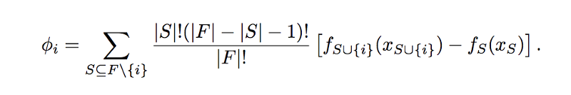
Shapley Value
The Shapley value, coined by Shapley (1953), is a method for assigning payouts to players depending on their contribution towards the total payout. Players cooperate in a coalition and obtain a certain gain from that cooperation
“finding each player’s marginal contribution, averaged over every possible sequence in which the players could have been added to the group”
Only method to fairly attribute the effect to all features
Contrastiveness: compare instances or subsets
Computation time: Number of possible coalitions increases exponentially by adding more features → appoximation
Does not return a prediction model like LIME
Explains difference between prediction and average prediction
Five players ABCDE
For C, possible coalitions: ABC-DE, BAC-DE, ABC-ED, BAC-ED
Weighted average of marginal contribution
R
iml
Python
shap

Slide 16
To Wrap up
Decision tree: intuitive visualization; shallow tree preferred
Regression: intuitive explanation. More helpful for business decision making
Decision rule: intuitive explanation and compact. Suitable for business setting
PDP/ICE/ALE: visualizing impact of one or two features
Feature importance: importance in term of accuracy
LIME: selective explanation for individual
Shapley value: the only method to provide complete explanation, can potentially be used in compliance scenario

Slide 17
Let’s Explain!
Contrastive
Selected
Social
Focus on the abnormal
Coherent with prior beliefs
Truthful
Generalizable
Three datasets to choose from (or other data that you are interested in)
https://github.com/christophM/interpretable-ml-book/tree/master/data
Goal:
Create one visualization using one of the explainable models (regression, decision tree, rules)
Create one visualization applying one of the model-agnostic methods to explain a black box model
Add description to the visualizations
Useful packages and libraries
R：
Data manipulation: dplyr, plyr, reshape2
Decision tree: rpart
Black box models: caret, mlr, randomForest, gbm, xgboost
Model-agnostic explainer: iml, pdp, ICEbox, ALEplot, vip, lime
Visuzliation: ggplot2
Python:
Data manipulation: pandas, numpy
Machine learning models: scikit-learn, xgboost
Model-agnostic explainer: PDPbox, PyCEbox, eli5, lime, shap, scikit-learn

